Slide 1





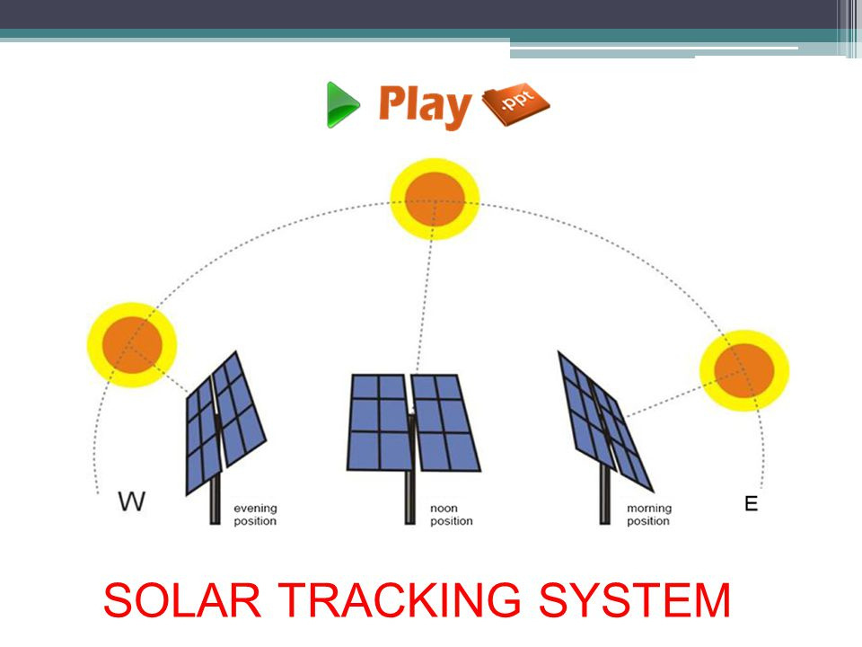
SOLAR PANEL WITH SUN POSITION TRACKING
PROJECT MEMBERS :
1.ADITYA REGE
2.SHASHANK MOOLYA
3.YASH DARADE
4.MANTHASHA SHAIKH
PROJECT MENTOR :
SANGEETHA P

Slide 2

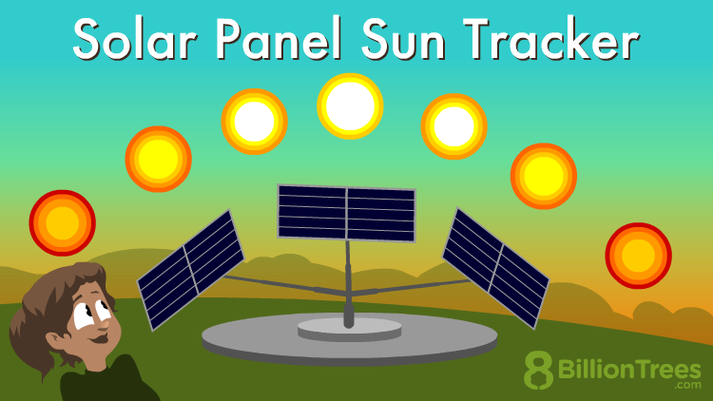
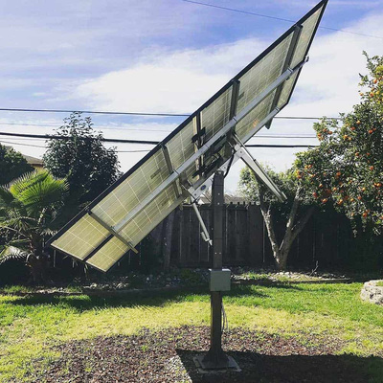

About
Sun tracking systems paired with solar panels are utilized to optimize energy production by continuously adjusting the panels' orientation to directly face the sun. This technology finds applications in various sectors such as Solar Power Plants , Commercial Installations , Agriculture , Residential Applications .
SUN TRACKING
Sun tracking systems are essential for maximizing the efficiency and output of solar energy systems across various applications, contributing to the advancement of renewable energy adoption and sustainability efforts.

Slide 3


IMPORTANCE
Sun tracking systems are designed to adapt to the seasonal variations in the sun's position. They ensure that solar panels remain aligned with the sun's trajectory throughout the year, optimizing energy capture regardless of changes in daylight hours or sun angles. This adaptability results in consistent energy generation year-round, providing a reliable and continuous power supply.
The use of sun tracking systems contributes to the advancement of renewable energy adoption and sustainability efforts. By maximizing the efficiency of solar energy generation, these systems help reduce reliance on fossil fuels, mitigate greenhouse gas emissions, and combat climate change. They play a crucial role in transitioning towards a more sustainable and environmentally friendly energy future.

Slide 4
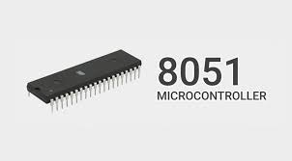
COMPONENTS
8051 Microcontroller
Stepper Motor
Resistors
Push Buttons
Capacitors
Transistors
Cables and Connector Diodes
PCB and Breadboards
LDRs

Slide 5
BLOCK DIAGRAM
8051
Stepper
motor
driver
Sensing
Element
Microcontroller
Stepper
MOTOR
Power supply
circuit

Slide 6
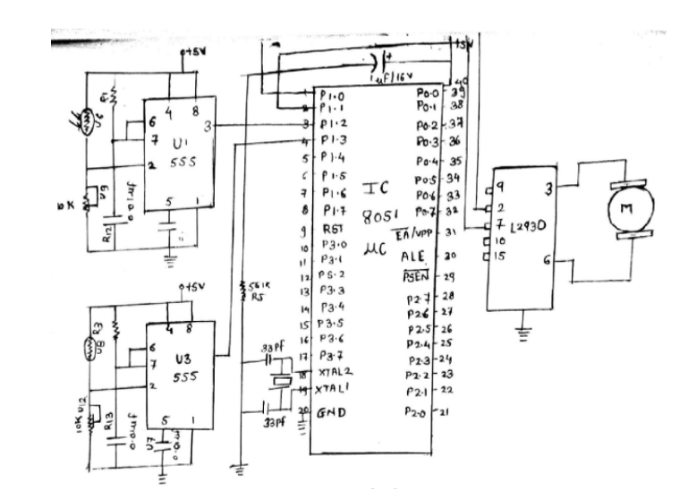
CIRCUIT DIAGRAM

Slide 7


Thank You

